Slide 1

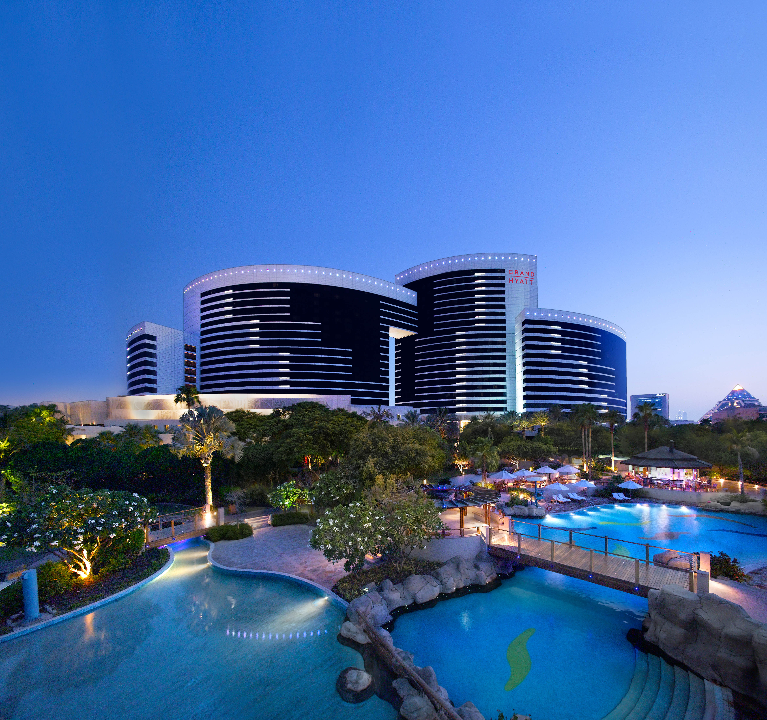
GRAND HYATT DUBAI
682 Guest Rooms
80,000 Sq. Ft. of Meeting Space
Hotel : Be Grand and Go Grand
Ballroom : Your One-Of-A-Kind conference
Show Kitchen : A Show kitchen like no other!
Dubai's Leading Conference hotel 3 years in a row
Centrally Located – Easy access to various Leisure facilities and the Dubai World Trade Centre
Highly Reliable and Flexible Events Team - Your Vision is our Mission
Grand Hyatt Dubai
Notes:
To edit position of “viewfinder” for longer headline, you must first select it. Once selected, right click and go to Group > Ungroup. From there you should be able to alter the 4 corners that create the “viewfinder”.

